Slide 1
Bus Reservation System
TEAM MEMBERS:
1. Akella Abhi Ram(team lead) Rollno-25A31A05AB
2. Merla Himesh Raj Rollno-25A31A05AP
3. Diddi Rama Satya Rollno-25A31A0571
4. Dora Kavya Sudha Rollno-25A31A0572

Slide 2
1.INTRODUCTION:
Bus Reservation System is used to manage bus booking details
It stores information like bus number, name, and seat availability
Manual systems are time-consuming and less efficient
Linked list helps in dynamic data storage and easy updates

Slide 3
CONCEPTS USED:
Linked List for storing bus records dynamically
Node structure to store data and link buses
Pointers to connect different nodes
Dynamic memory allocation for flexible storage
Traversal to access and display data

Slide 4
IMPORTANCE:
Provides efficient way to manage bus records
Makes insertion and deletion easier compared to arrays
Reduces memory wastage
Useful in real-world transport systems

Slide 5
WORKING:
Program starts with an empty linked list
User selects operations from menu
New buses are added as nodes
Search operation finds specific bus
Reservation updates available seats
Delete removes bus from system

Slide 6
ALGORITHMS:
Add Bus: Insert new node at end
Display Bus: Traverse and show details
Search Bus: Compare bus numbers
Reserve Seat: Decrease available seats
Cancel Seat: Increase available seats
Delete Bus: Remove node from list

Slide 7
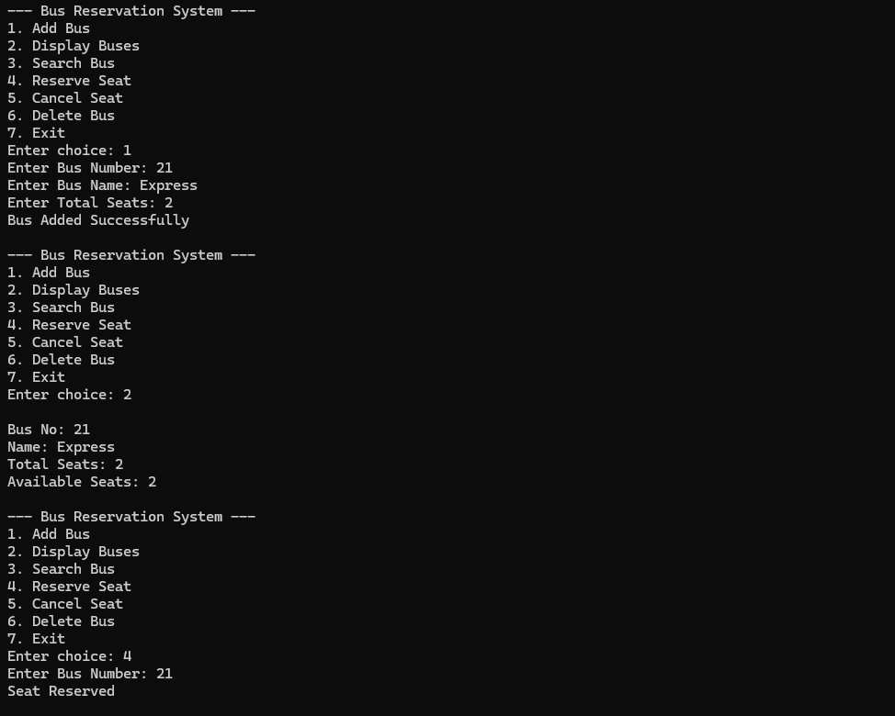
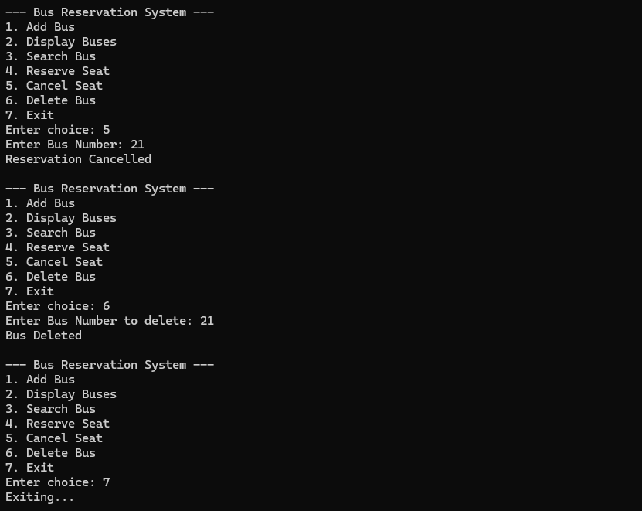
Outputs:

Slide 8
ADVANTAGES
Dynamic memory allocation
Easy insertion and deletion
Efficient data handling
Simple and flexible implementation

Slide 9
Conclusion:
Successfully implemented bus reservation system
Demonstrates working of linked list
Efficient for managing dynamic data
Helps understand real-world applications

Slide 10
Thank you

